Slide 1


upcome
Providing visibility for rising stars.
Notes:
<number>

Slide 2

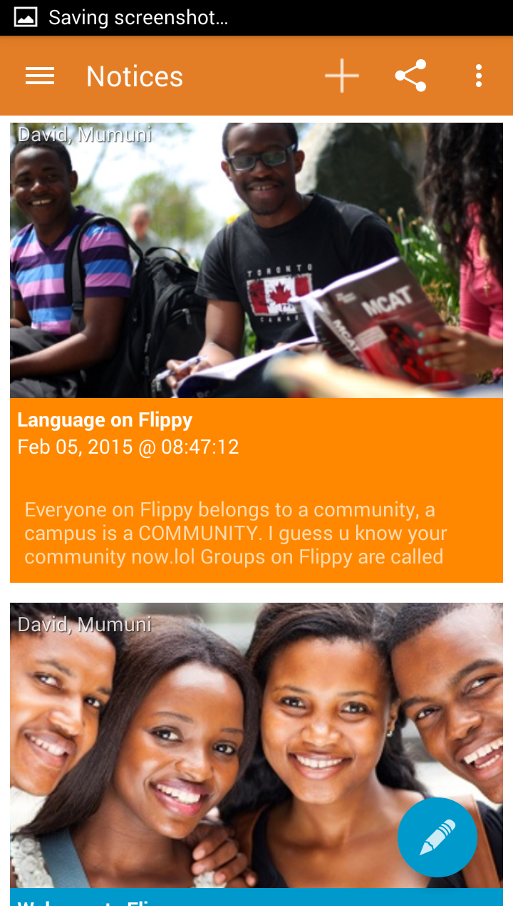
Upcome
An app that makes
It super easy
for upcoming music
artists to be discovered
Instantly.
Notes:
Musicians are already showing interest
<number>

Slide 3
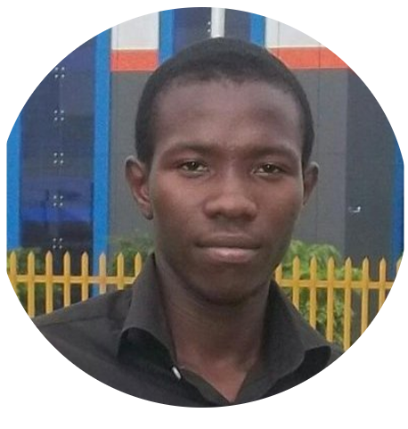

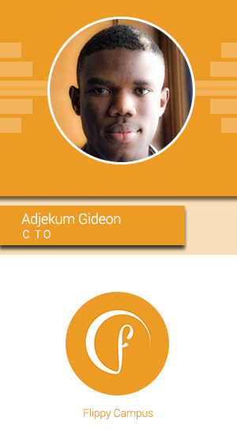

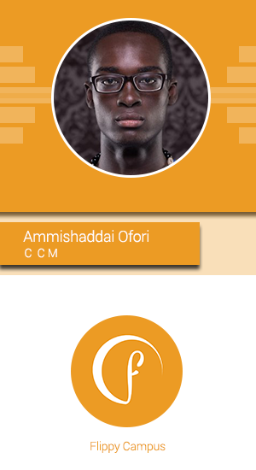
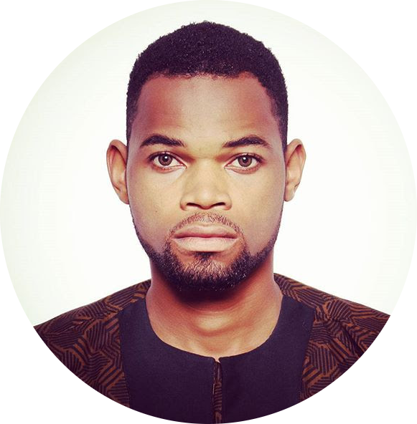
Passionate Team
Ibukun
Muyide
Henry Mascot
Amanze
Ogbonna
Notes:
Team Flippy and advisory board
<number>

Slide 4
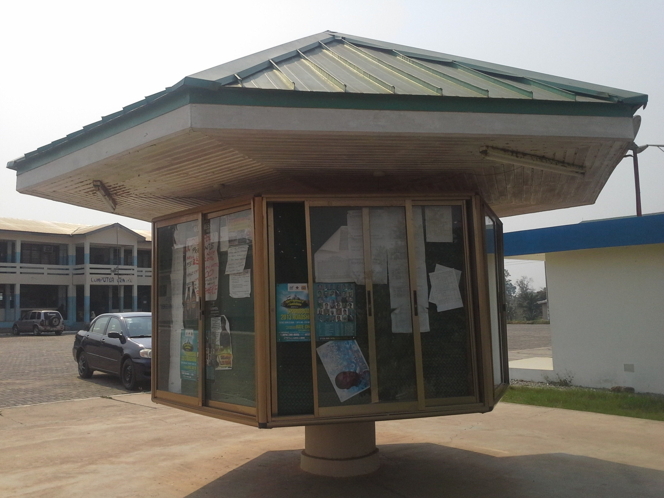
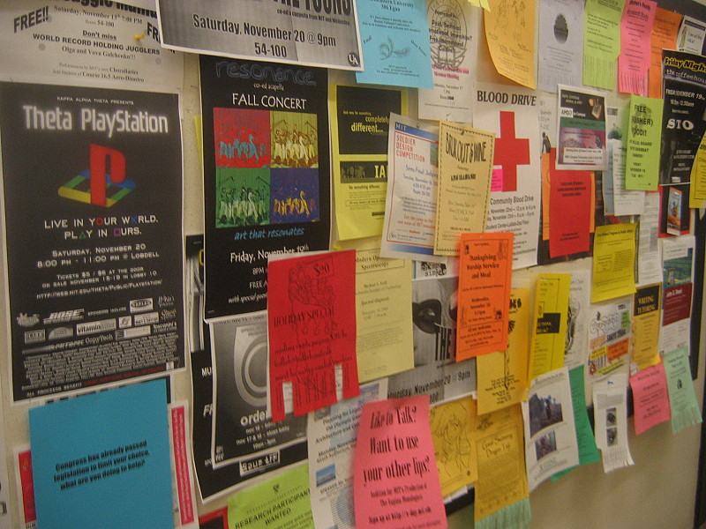
Problem
Notes:
<number>

Slide 5
Solution
A full scale multi-platform cloud based music service that leverages on
Mobile
Location
Carrier Billing
Data
Location
Notes:
<number>

Slide 6
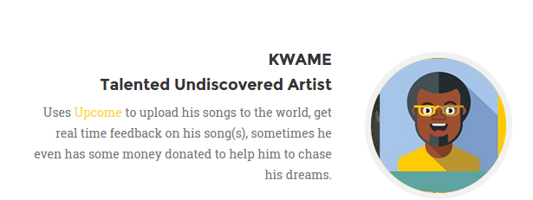
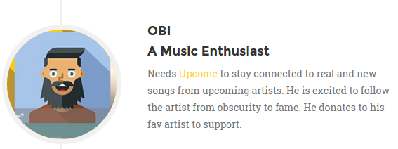
Who is it for?
Notes:
<number>

Slide 7

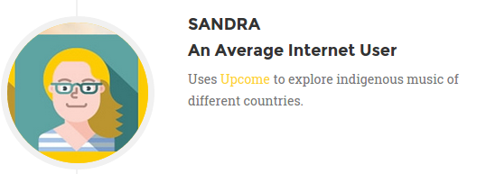
Notes:
<number>

Slide 8
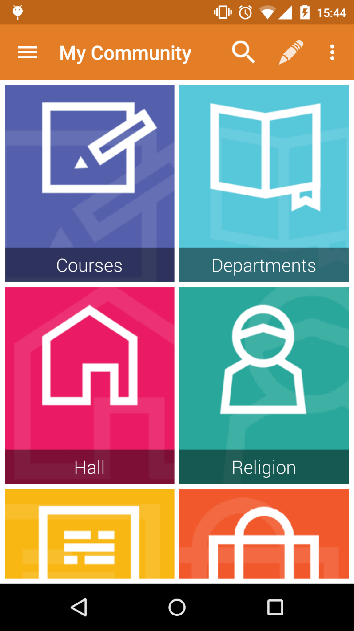
…what to do on Upcome
Share New Music
Network with Fans
Get discovered
Get Sponsored
Get feedback
Listen to new music
Notes:
<number>

Slide 9
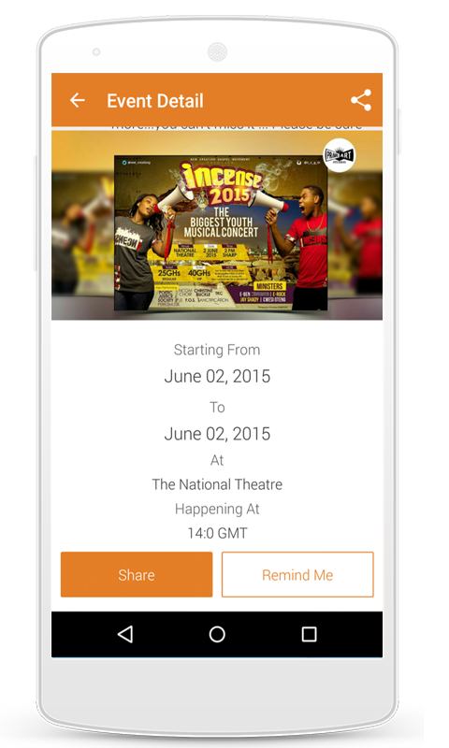
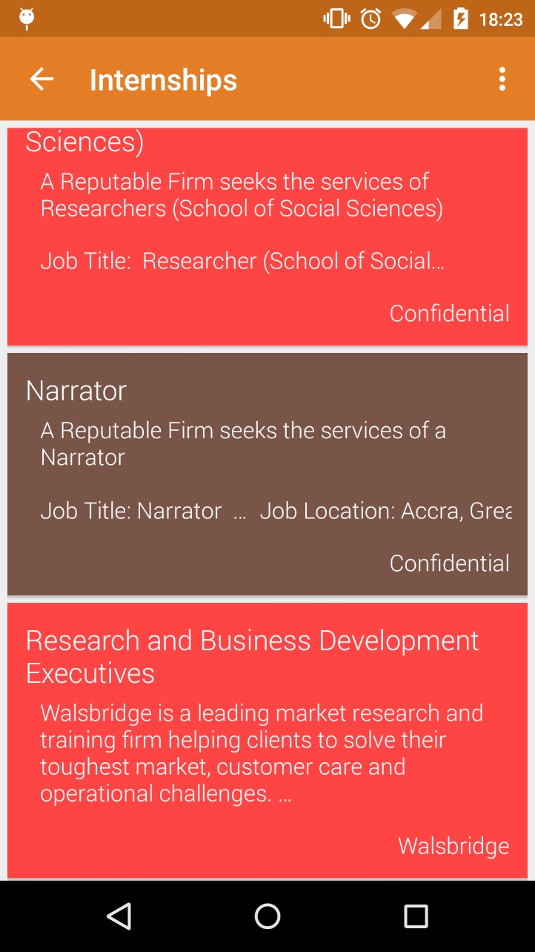
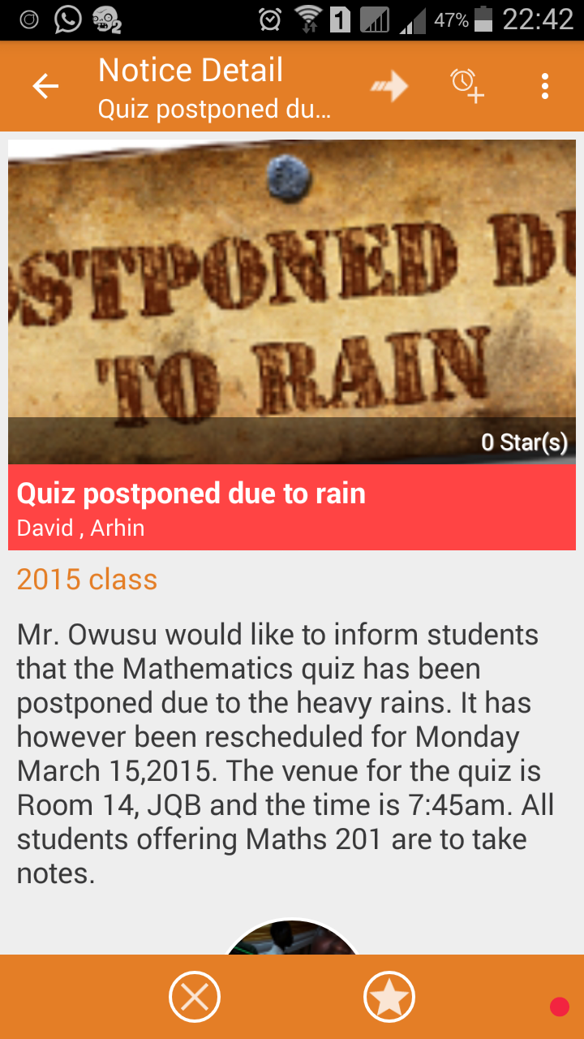
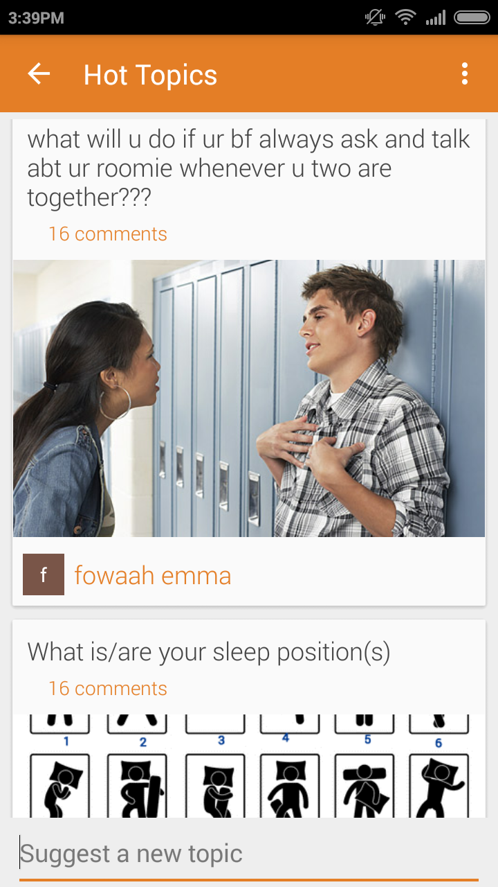
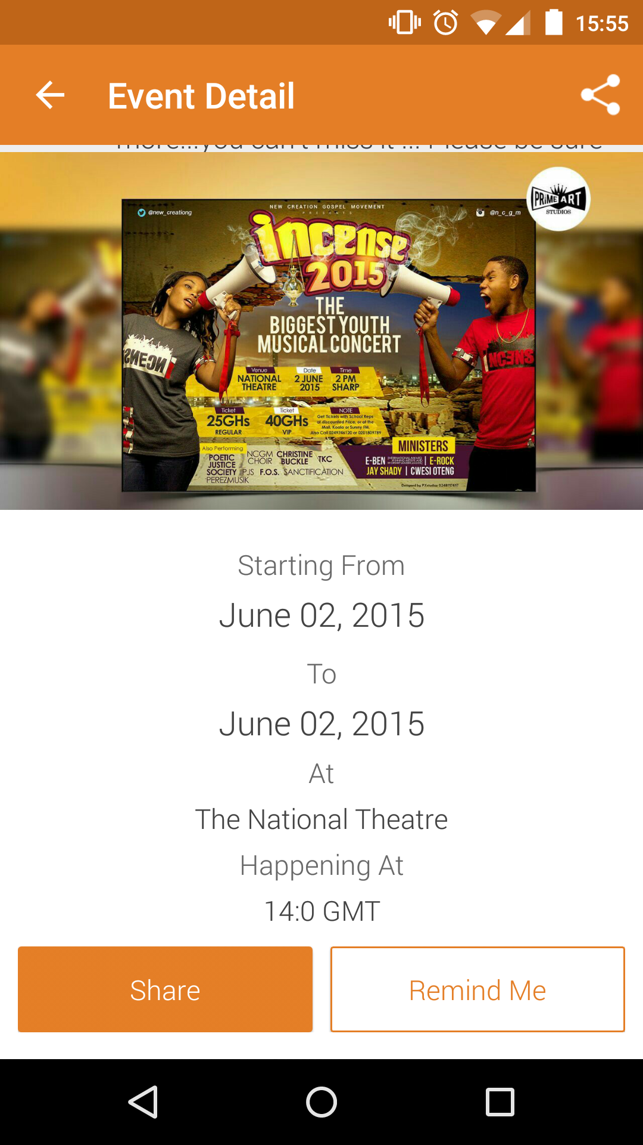
Notes:
<number>

Slide 10


Market Potential
350,000 students
108 tertiary institutions
Africa
Ghana
Notes:
<number>

Slide 11
Market Potential
Informal statistics from Nigerian entertainment executives show that ringtones sold to the tune of $150 million in 2011, global live performances brought in an additional $105 million, and album sales reached $30 million in 2008 (three times more than 2005), PolitiFact reports. - See more at:
http://afkinsider.com/68131/big-africas-music-export-industry/#sthash.cRkCN1kg.dpuf
Notes:
<number>

Slide 12




…who we are up against
Notes:
<number>

Slide 13

…what’s next?
December 2015
June
2016
Oct '15
Launch AIRTEL
APP
FINALE
80,000
users
200,000
users
September

Slide 14
Revenue Model
1. ADVERTISING
2. COMMISSIONS
3. PAID PLACEMENT

Slide 15
upcome
The ultimate platform for rising stars.
Notes:
<number>

